Slide 1
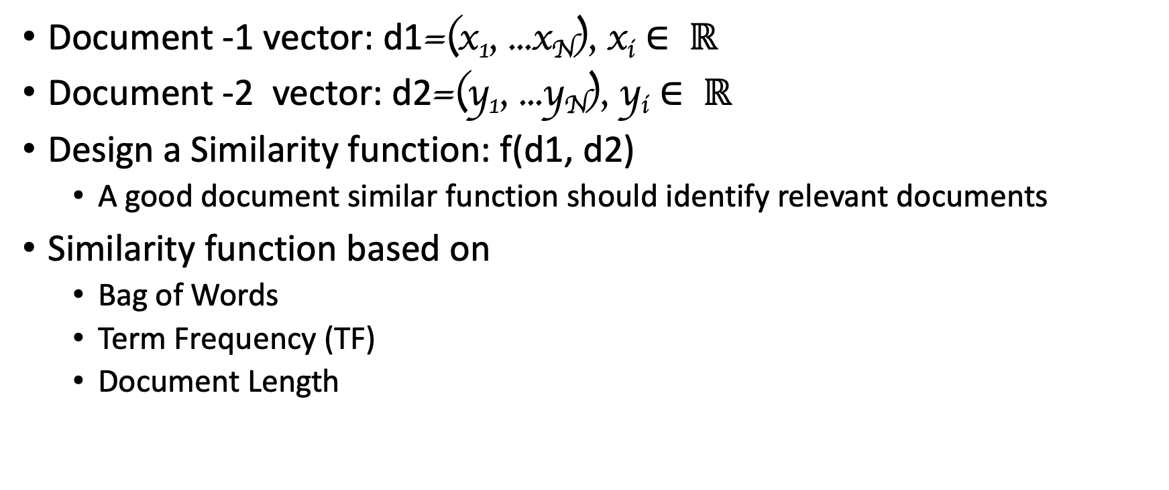
Document Classification
Document -1 vector: d1=(x₁, ...x_{N}), x_{i} $∈ ℝ$
Document -2 vector: d2=(y₁, ...y_{N}), y_{i} $∈ ℝ$
Design a Similarity function: f(d1, d2)
A good document similar function should identify relevant documents
Similarity function based on
Bag of Words
Term Frequency (TF)
Document Length

Slide 2
Many Similarity Function
Distance Function (q, d)
Vector space model
Probabilistic models P(s=1 | q, d)
Probabilistic inference model f(q, d) = p(d→q)
Axiomatic model
Deep Learning

Slide 3
Vector Space Model (VSM) Assumptions
Terms are assumed to be orthogonal (independent from each other)
Term: basic concepts such as word or phrase (n-gram)
N terms define an N-dimensional space
Vector Placements base on Terms (w₁, ...w_{N})
Term weight in query and document indicates how well the term characterizes the document or query.
We need to define a similarity function Distance Function (q, d)
for measuring the relevance.

Slide 4
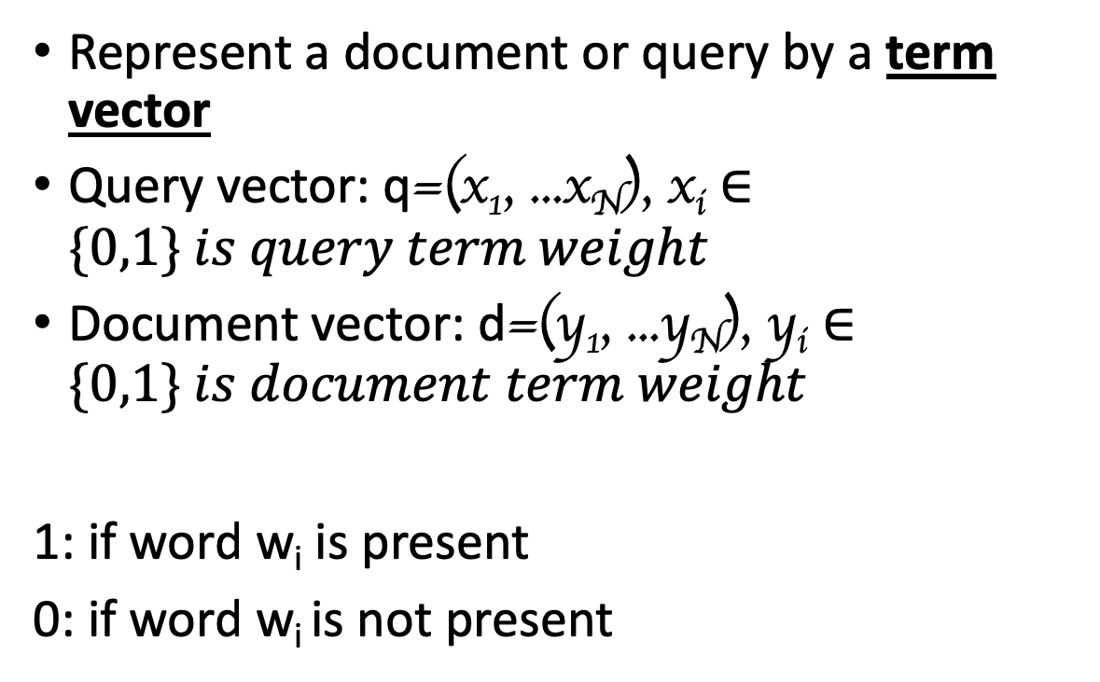
Bit Vector Presentation
Represent a document or query by a term vector
Query vector: q=(x₁, ...x_{N}), x_{i} $∈\{0,1\} is query term weight$
Document vector: d=(y₁, ...y_{N}), y_{i} $∈\{0,1\} is document term weight$
1: if word w_{i} is present
0: if word w_{i} is not present
w3
N-dimensional space,
Dictionary = (w₁, ...w_{N})
q=(x₁, ...x_{N})
d=(y₁, ...y_{N})
w2
w1

Slide 5

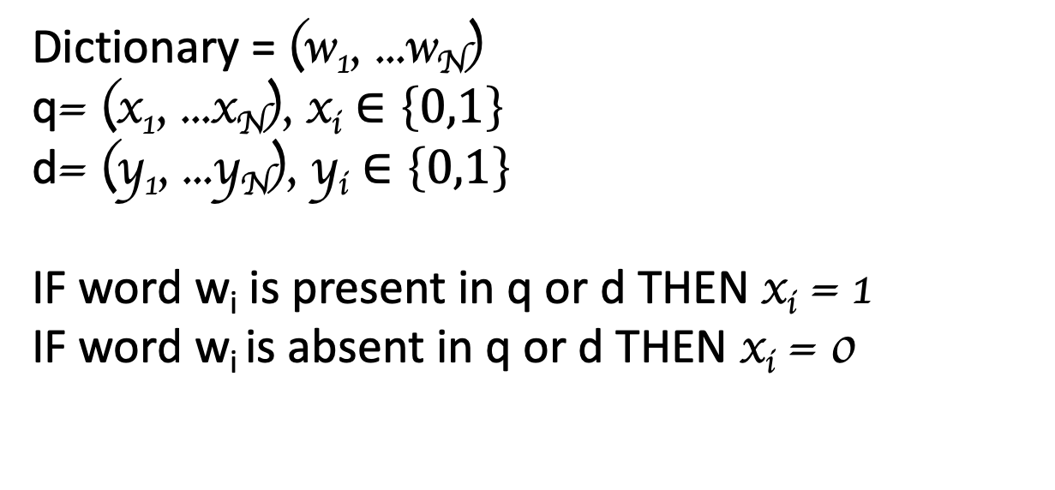

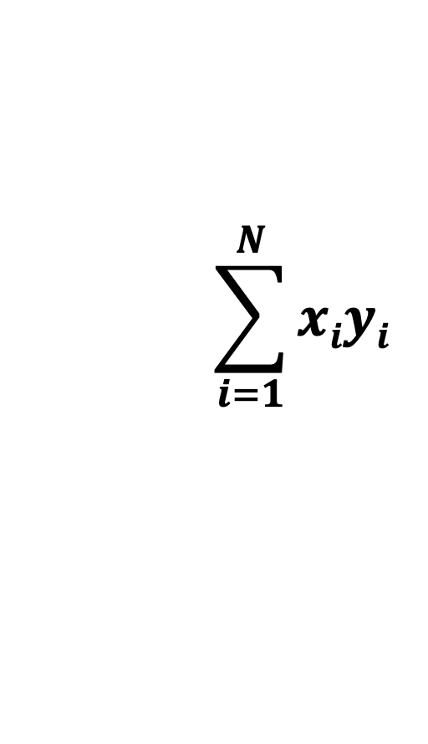


Similarity → Distance Function: DoT Product
Dictionary = (w₁, ...w_{N})
q= (x₁, ...x_{N}), x_{i} $∈\left\{0,1\right\}$
d= (y₁, ...y_{N}), y_{i} $∈\left\{0,1\right\}$
IF word w_{i} is present in q or d THEN x_{i} = 1
IF word w_{i} is absent in q or d THEN x_{i} = 0
$$\sum_{i=1}^{N}{xiyi}$$
$$→$$
$$→$$
.
D (q, d) =
$$q$$
$$d$$
= x₁y₁ + x₂y₂ + …. x_{n}y_{n} =

Slide 6
Example 1
I hate running
I like NLP
I like deep learning
Terms = {I, like, hate, Deep, Learning, NLP, flying}

Slide 7
Example 2
Query = news about sport campaign
Document 1 = .. news about food campaign
Document 2 = .. news of sport campaign
Document 3 = .. news of sport campaign … sport activities ..

Slide 8
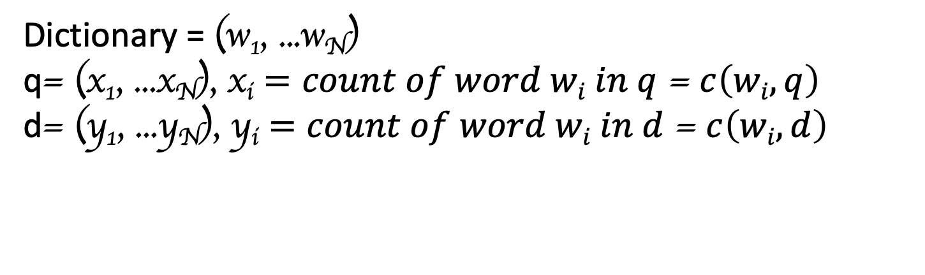

Similarity → Distance Function: DoT Product Improved SVM with Term Frequency Weighting
Dictionary = (w₁, ...w_{N})
q= (x₁, ...x_{N}), x_{i} $=count of word wi in q$ = $c\left(wi,q\right)$
d= (y₁, ...y_{N}), y_{i} $=count of word wi in d$ = $c\left(wi,d\right)$
$$\sum_{i=1}^{N}{c\left(w,q\right)c\left(w,d\right)}$$
$$→$$
$$→$$
.
D (q, d) =
$$q$$
$$d$$
= x₁y₁ + x₂y₂ + …. x_{n}y_{n} =

Slide 9
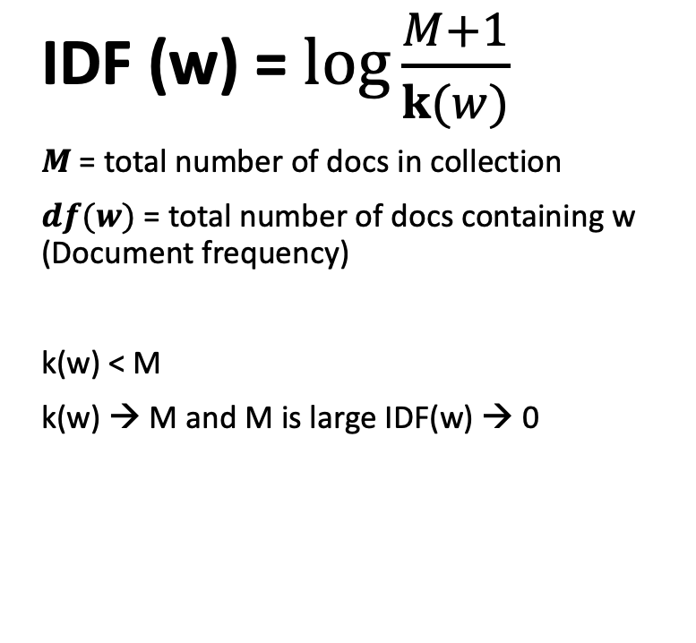
IDF Weighting Penalizing popular terms
IDF (w) = $\log{\frac{M+1}{k(w)}}$
$M$ = total number of docs in collection
$df(w)$ = total number of docs containing w (Document frequency)
k(w) < M
k(w) → M and M is large IDF(w) → 0
IDF(w)
Log(M+1)
k
Document Frequency

Slide 10
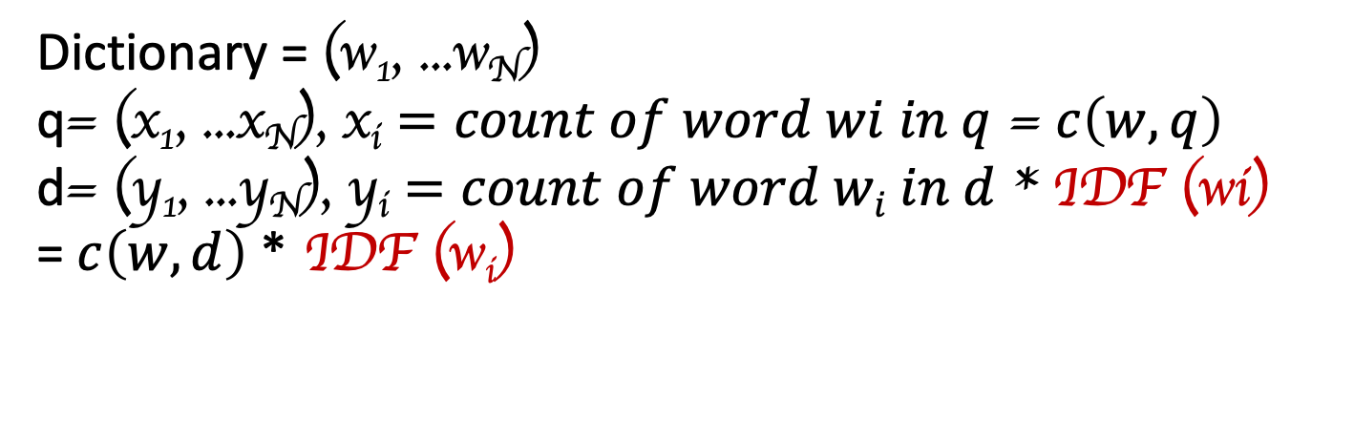
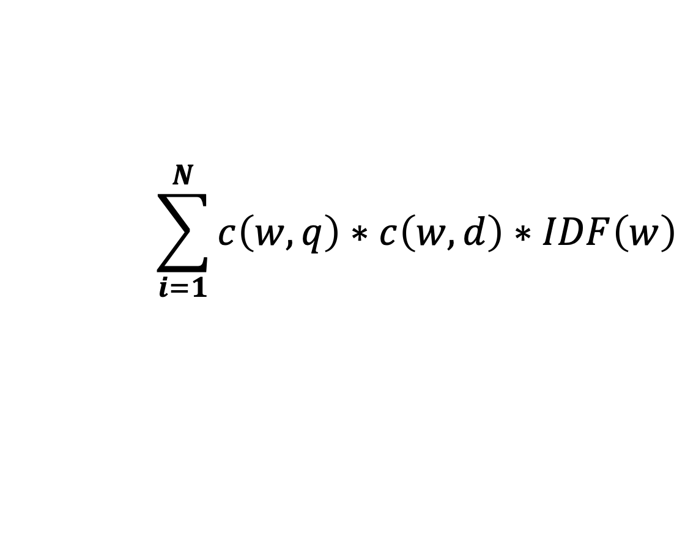
Similarity → Distance Function: DoT Product Further Improvement of Vector Placement Inverse Document Frequency (IDF)
Dictionary = (w₁, ...w_{N})
q= (x₁, ...x_{N}), x_{i} $=count of word wi in q$ = $c\left(w,q\right)$
d= (y₁, ...y_{N}), y_{i} $=count of word wi in d$ * IDF (wi)
= $c\left(w,d\right)$ * IDF (w_{i})
$$→$$
$$→$$
.
D (q, d) =
$$q$$
$$d$$
= x₁y₁ + x₂y₂ + …. x_{n}y_{n}
=
$$\sum_{i=1}^{N}{c\left(w,q\right)∗c\left(w,d\right)∗IDF\left(w\right)}$$

Slide 11
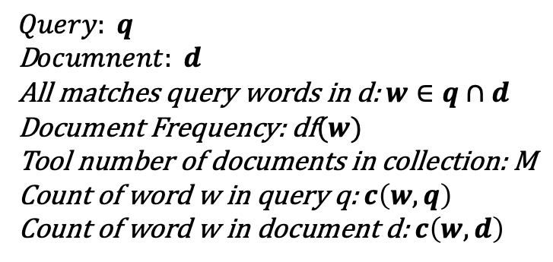
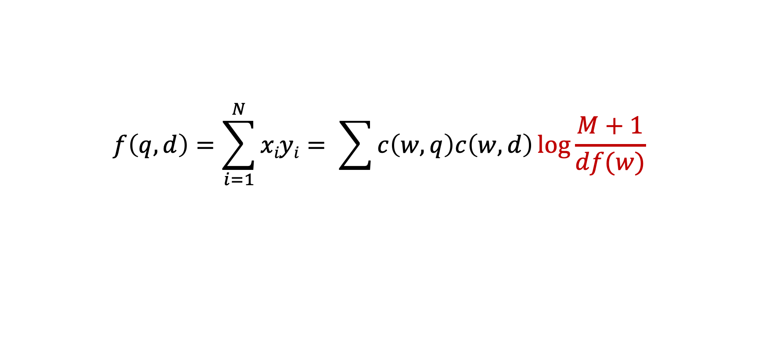

Similarity Function with TF-IDF Weighting
$$f\left(q, d\right)=\sum_{i=1}^{N}{xiyi}= \sum{c\left(w,q\right)c\left(w,d\right)\log{\frac{M+1}{df(w)}}}$$
TF(w)
$$IDF\left(w\right)$$
$$Query: q$$
D$ocumnent: d$
All matches query words in d: $w∈q∩d$
Document Frequency: df$(w)$
Tool number of documents in collection: M
Count of word w in query q: $c\left(w,q\right)$
Count of word w in document d: $c\left(w,d\right)$

Slide 12

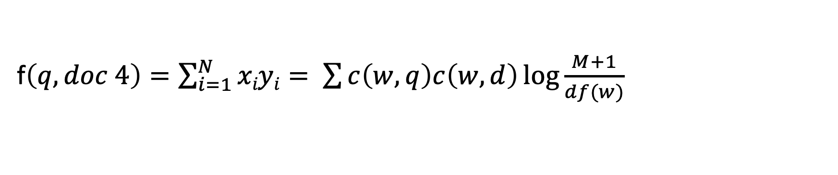
Example 2
Query = news about sport campaign
Document 1 = .. news about food campaign
Document 2 = .. news of sport campaign
Document 3 = .. news of sport campaign … sport activities ..
Document 4 = .. news of food campaign … campaign … campaign
f$\left(q, doc 4\right)=\sum_{i=1}^{N}{xiyi}= \sum{c\left(w,q\right)c\left(w,d\right)\log{\frac{M+1}{df(w)} }}$
c (“campaign”, doc4) * $\log{\frac{5}{4}= }$

Slide 13
BM25 Transformation
K →
8
y= TF (w,d)
Y = x
x →
8
Y = k+1
(k+1)x
Y =
k + x
Bit Vector Presentation
k = 0
x= c(w,d)

Slide 14
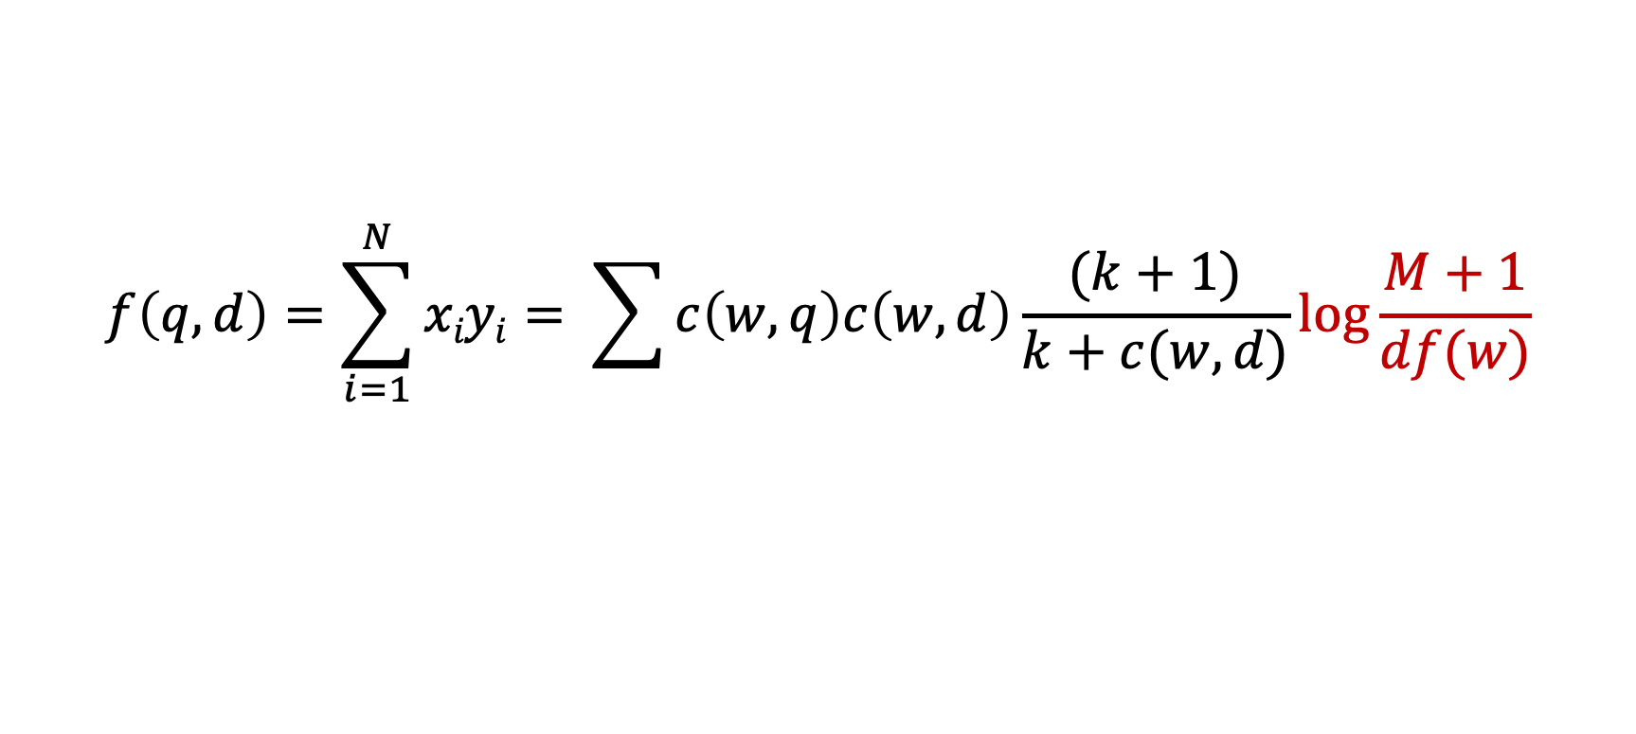
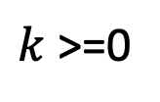
BM25 Transformation
$$f\left(q, d\right)=\sum_{i=1}^{N}{xiyi}= \sum{c\left(w,q\right)c\left(w,d\right)\frac{(k+1)}{k+c(w,d)}\log{\frac{M+1}{df(w)}}}$$
K →
8
$k$ >=0
y= TF (w,d)
Y = x
Y = ln (1+ ln( 1 + c(w,d)))
x →
8
Y = k+1
(k+1) c(w,d)
Y =
k + c(w,d)
Bit Vector Presentation
k = 0
x= c(w,d)

Slide 15
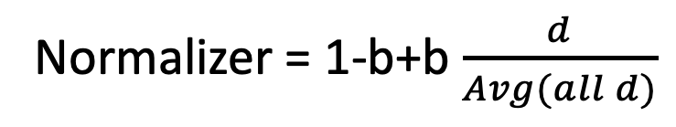
Document Length Normalization
A long document has a higher chance to match any query so we should penalize the document length
Normalizer = 1-b+b $\frac{d}{Avg(all d)}$
b is [0, 1]

Slide 16
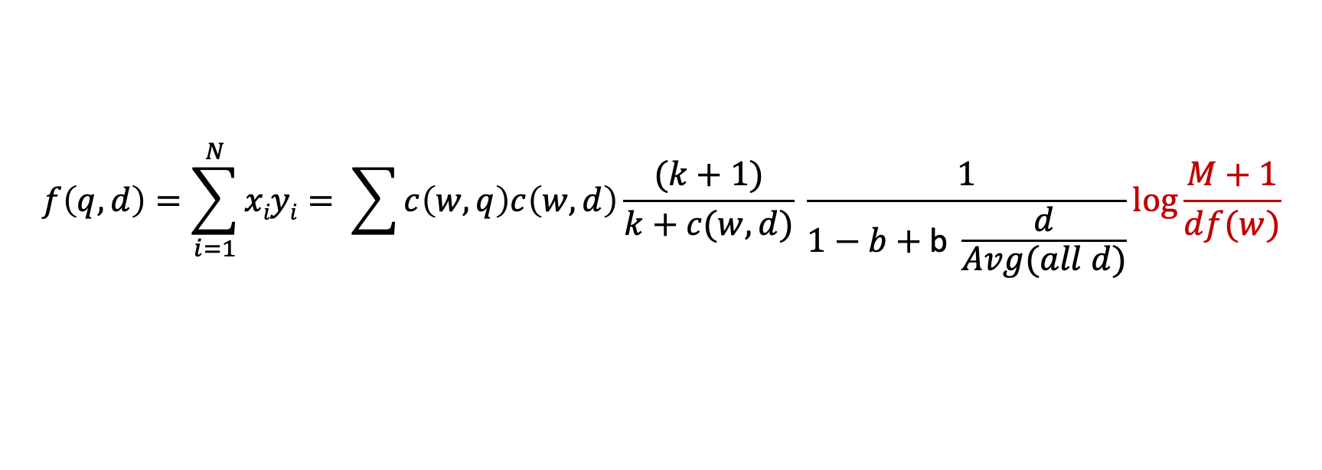
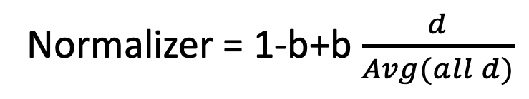
BM25/Okapi
A long document has a higher chance to match any query so we should penalize the document length
Normalizer = 1-b+b $\frac{d}{Avg(all d)}$
b is [0, 1]
$$f\left(q, d\right)=\sum_{i=1}^{N}{xiyi}= \sum{c\left(w,q\right)c\left(w,d\right)\frac{(k+1)}{k+c(w,d)} \frac{1}{1−b+\text{b} \frac{d}{Avg(all d)}}\log{\frac{M+1}{df(w)}}}$$

Slide 17
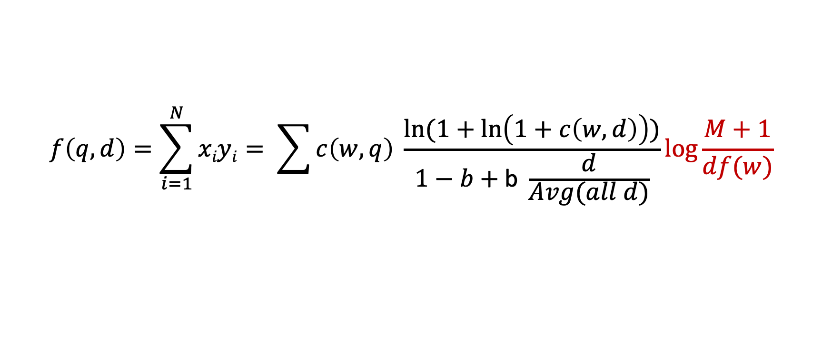
Pivoted Length Normalization VSM
$$f\left(q, d\right)=\sum_{i=1}^{N}{xiyi}= \sum{c\left(w,q\right) \frac{ln⁡(1+\ln\left(1+c\left(w,d\right)\right))}{1−b+\text{b} \frac{d}{Avg(all d)}}\log{\frac{M+1}{df(w)}}}$$

